Slide 1
16s Microbiome Analysis workshop
International Microbiome Centre
June 15-16, 2020
Disclaimer: These slides are taken from difference sources on the web and some are modified. I have added sources but if I have missed some, I apologize in advance to the original content creators.

Slide 2
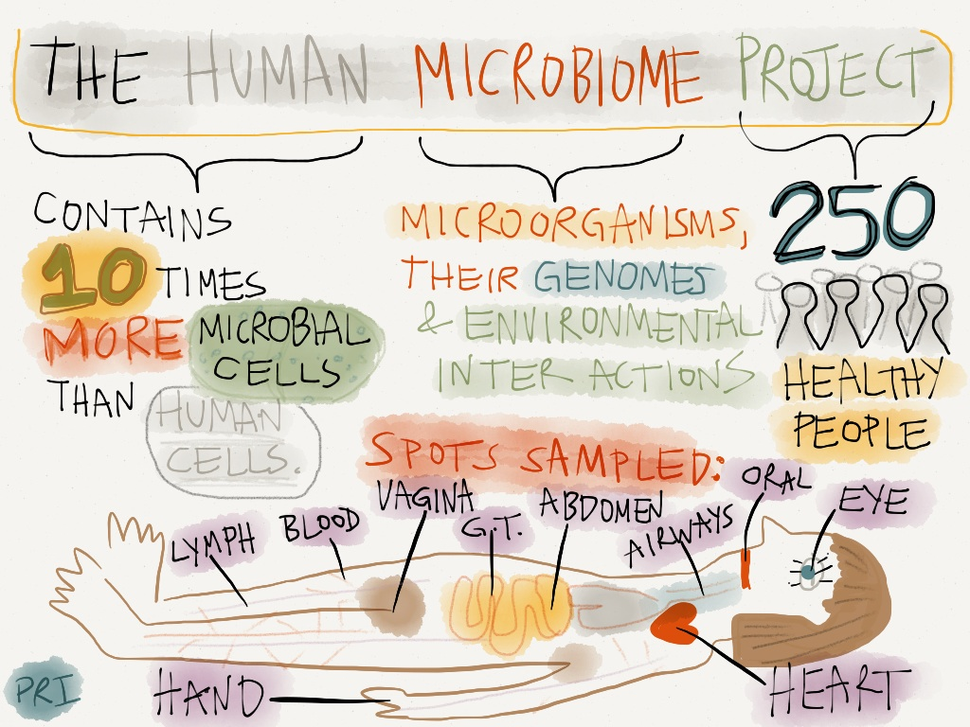

Slide 3
Who lives here?
Over time
Treatment
+

Slide 4
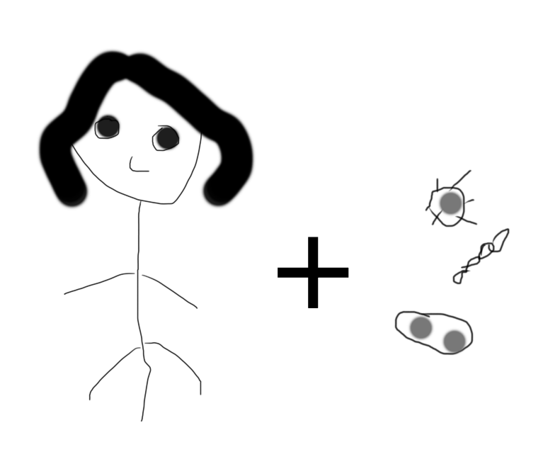
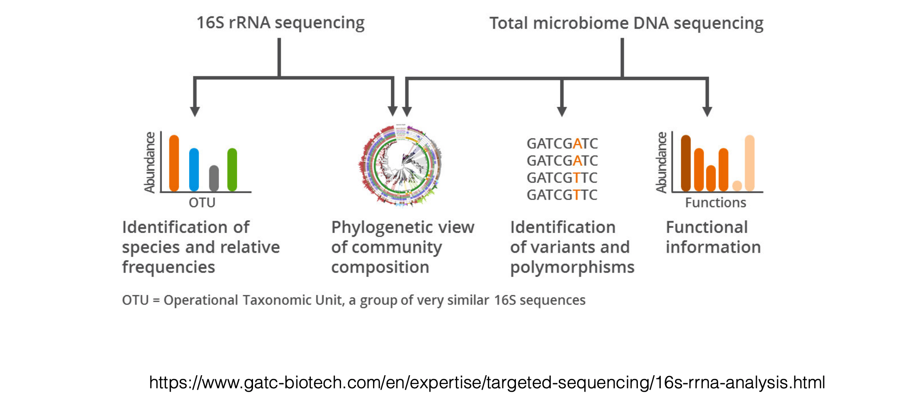
Amplicon Sequencing
Total microbiome DNA sequencing

Slide 5
Amplicon Sequencing
What should we amplify?

Slide 6
The Small Subunit ’16s’ ribosomal RNA gene
0
1500 bp
V1
V2
V3
V4
V5
V6
V7
V8
V9
Conserved Regions Variable Regions
Because this gene is conserved and found in most bacteria, it is used for reconstructing phylogeny.
Depending on the hypervariable region picked, you can classify to different level of taxonomy

Slide 7
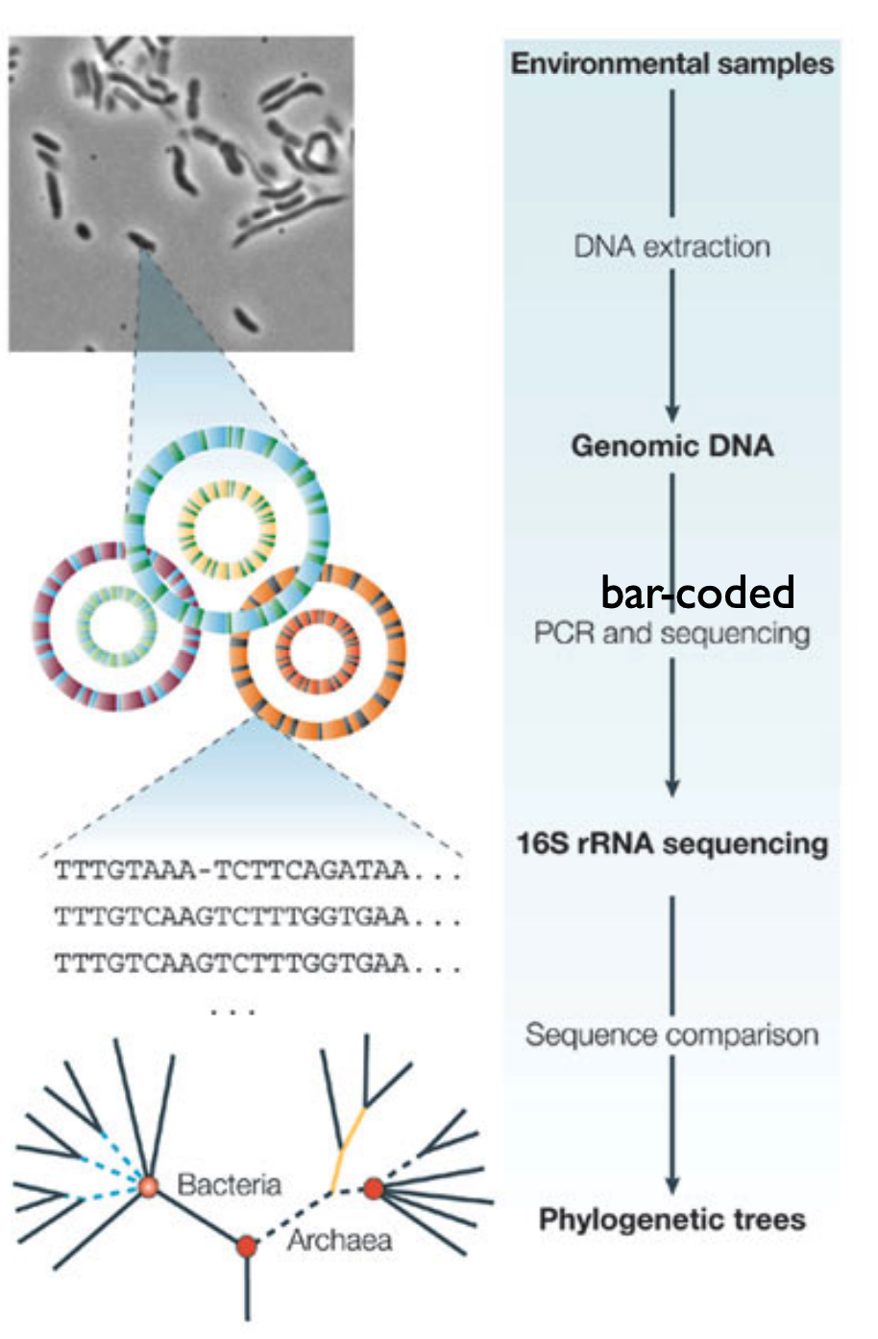
Many microbiomes in parallel
Break all cells, extract all DNA
PCR-amplify 16s rRNA genes using bar-coded primers
Sequence samples
Cluster sequences after De-multiplexing for each sample
Count each species
https://www.biostat.washington.edu/sites/default/files/modules/2018-SISMID-01b.pdf

Slide 8
Any pitfalls ?

Slide 9
Bioinformatics to the rescue !!!

Slide 10
1
2
Sequencing results
Woah! That is a lot of data
3
4
Bioinformatics Tools
Biological Knowledge
Source: LEGO+Johnathan Irish

Slide 11
Thoughtful data analysis is critical for successful taxonomic assignment

Slide 12
What do we know about our data?
16s Region
Which region was sequenced, read length & depth
Negative Controls
Was a negative control included?
Feasibility
Will this data answer the questions asked by the investigator?
Read Assignment
Are the reads assigned correctly to each sample?
Sample size
Are there enough samples for down stream analysis

Slide 13
16 rRNA
0
1500 bp
V1
V2
V3
V4
V5
V6
V7
V8
V9
Conserved Regions Variable Regions
Pick a variable region
V3-V4
Pick a sequencing technique
Illumina (MiSeq)
Select primers & Read lengths
Overlap
FWD
Primer
Read length
Primer
REV
Make sure there is an overlap!!!!

Slide 14
How to calculate V region overlap
Overlap
FWD
Primer
Read length
Primer
REV
Overlap=Read length *2 – primer_F- primer_R – VR_length
Example: V4 VR_length=254 bp, read length =250 x2 bp and primers=20 bp
Overlap= 250 *2 – 20- 20 – 254
= 206

Slide 15

Always have a blank sample sequenced with your samples

Slide 16
Typical Workflow

Slide 17
The common path
Reads
Quality
Control
Denoise
Clustering
Classify
Check Read Quality
Correct Errors
Define Clusters
Select Database
Remove Primers
Dereplicate
Check CHIMERA
Assign Taxonomy
Quality Filter & Truncation
Merge Reads
Phix Contamination
How do we select the tools and use them well ?

Slide 18
Paired End Reads
Overlap
FWD
Primer
Read length
REV
Region | Read length | Amplicon Length | Overlap
V3 | 150 | ~170 | 130
V3-V4 | 300 | ~462 | 133
V4 | 150 | ~254 | 46
V4 | 250 | ~254 | 246
% of bases > Q30
Read Length PE
Source: Illumina
Notes:
The amplicon/fragment is read from either end and this is used to generate the read pairs .

Slide 19
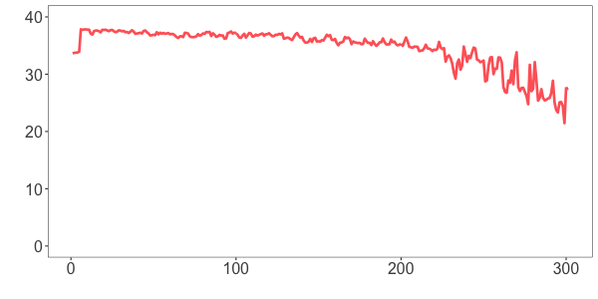
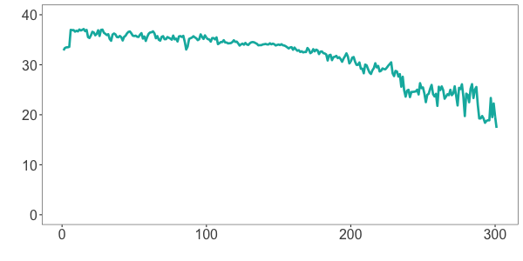
Base Quality differs between Fwd and Rev Reads
Primer
FWD
REV
Average Quality Score
Forward
Reverse
0
100
200
300
400
Base position in a read
Tools
FastQC FastQp MultiQC & Specialized 16s rRNA packages
Source: Dada2 R package

Slide 20
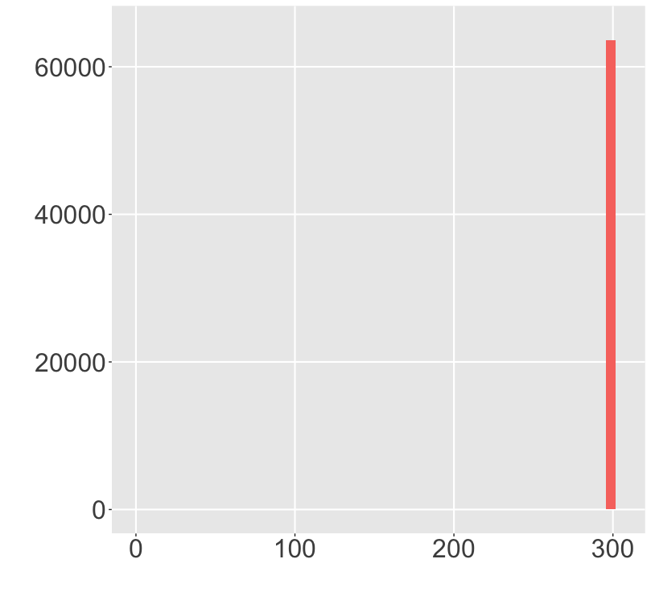
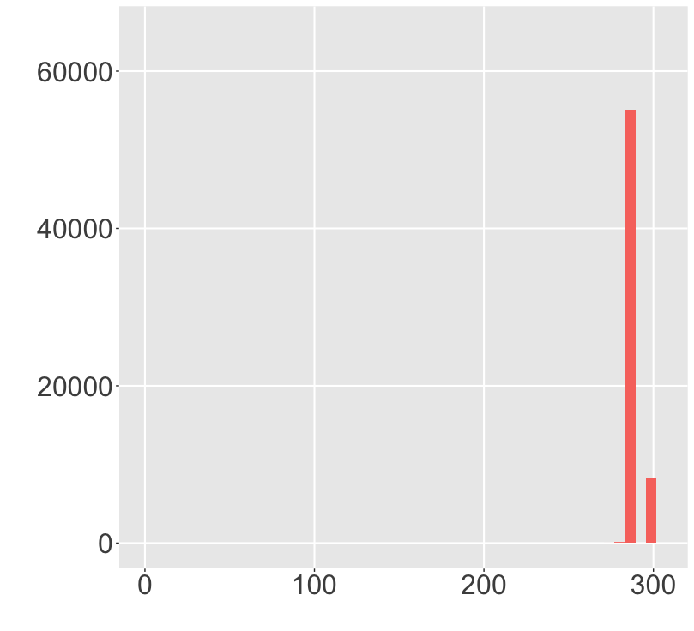
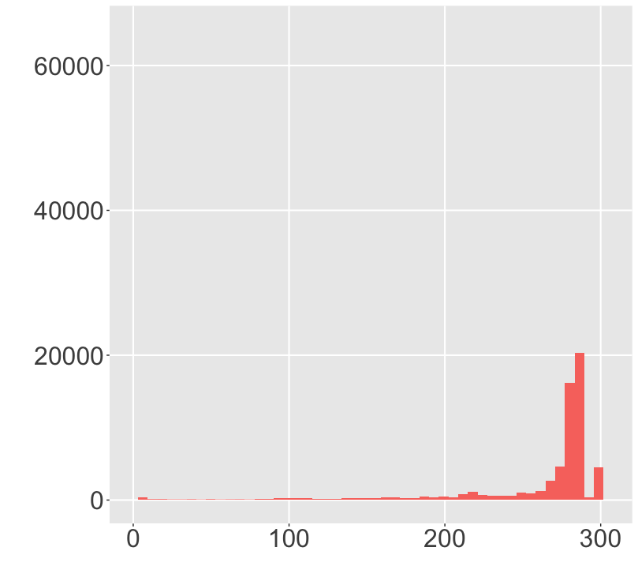
Trimming & Quality Filtering
Raw Reads
Remove Primers
Quality Trimming
Counts
Read Length
Read Length
Read Length
Tools
CutAdapt

Slide 21
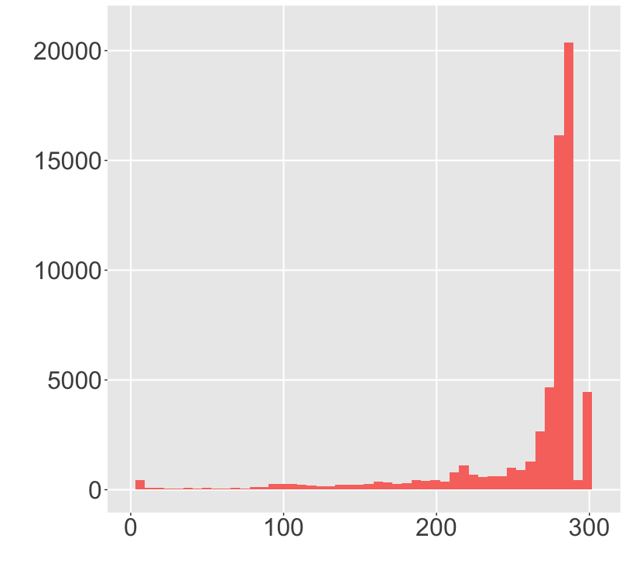
Trimming & Quality Filtering
Available Methods
Minimum Q (Q >= 20)
Truncate if 3 consecutive bases are Q < 3
Expected Errors
Truncation
Counts
Read length | % of reads
10 | 98.96
100 | 96.97
200 | 89.3
250 | 80.5
Read Length
Source: Edgar et al., 2015

Slide 22
Why PhiX?
Caution
Low diversity
Significant number of reads have the same sequence
PhiX Contamination
Illumina removes PhiX
Assigned to samples
(1%-12%)
Quality Control
Cluster Generation
Phasing & Prephasing
Removal
Blast sample reads against PhiX genome
Source: Illumina
Source: Mukherjee et al.,2015
Notes:
Each dna strand in a cluster is extended by one nucleotide, a smalll proporation of strands may out phase the current cycle.

Slide 23
Denoising reads

Slide 24
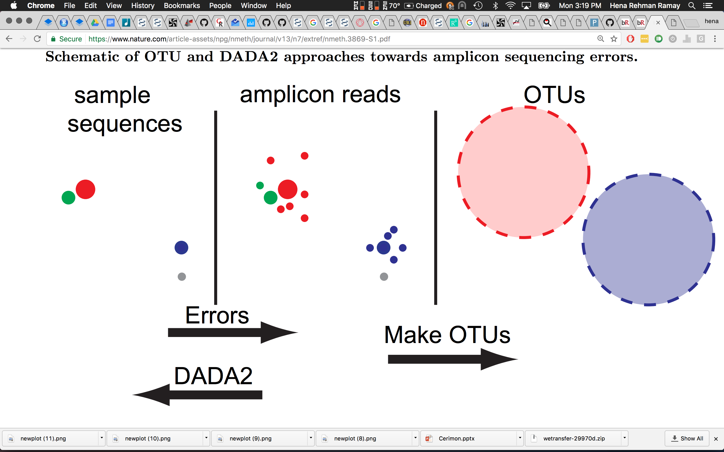
Clustering
(Operational taxonomic Unit)
97 % Identity
97 % Identity
(OTUs are not strains)
OTUs: Lump similar sequences together
DADA2: Statistically infer the sample sequences (Amplicon sequence variants: ASVs)
Source: Callahan et al.,2016

Slide 25
Clustering
97 % Identity
97 % Identity
DADA2
High Resolution & Accuracy
Source: Callahan et al.,2016
Notes:
High Resolution: DADA2 infers exact sequence variants from amplicon data, resolving differences of even 1 or 2 nucleotides.
Accuracy: DADA2 reports fewer false positive sequence variants than other methods report false OTUs.

Slide 26
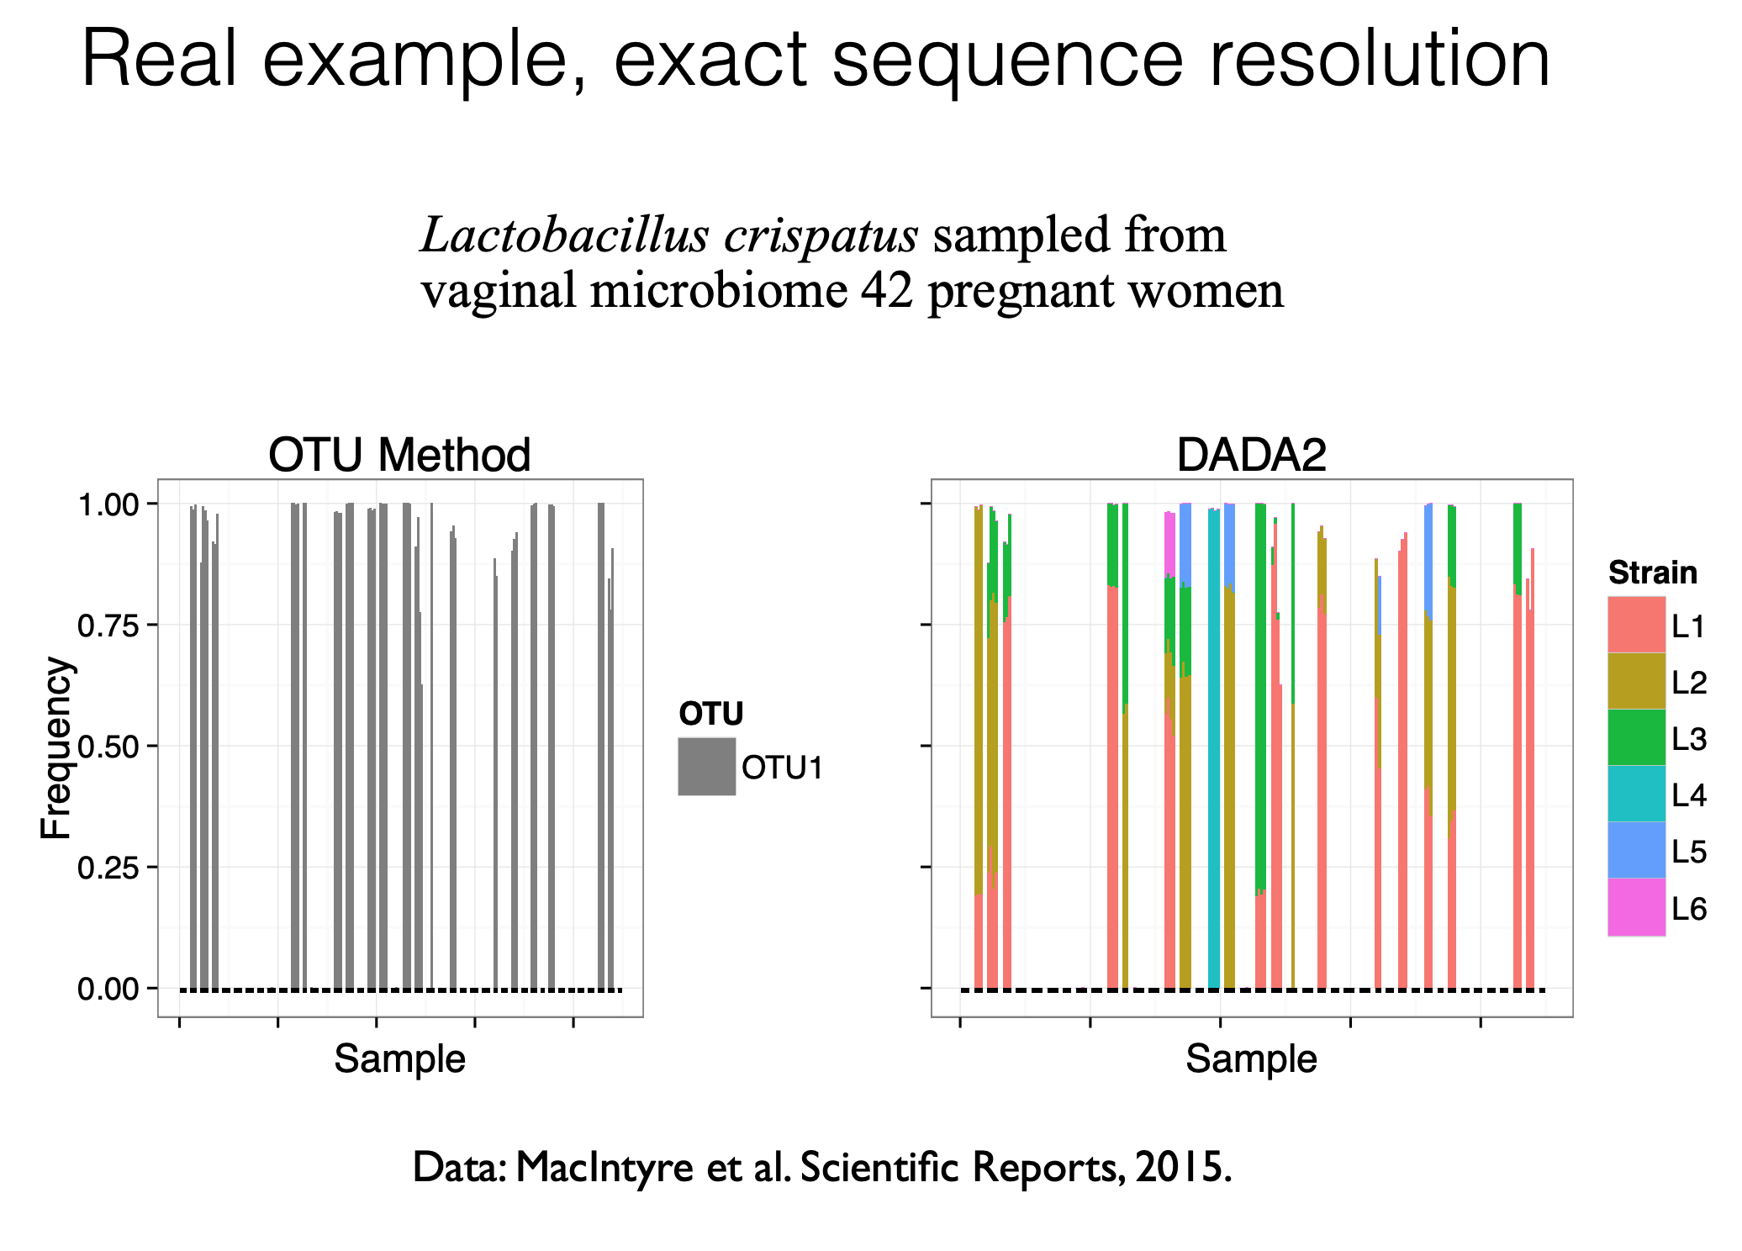

Slide 27
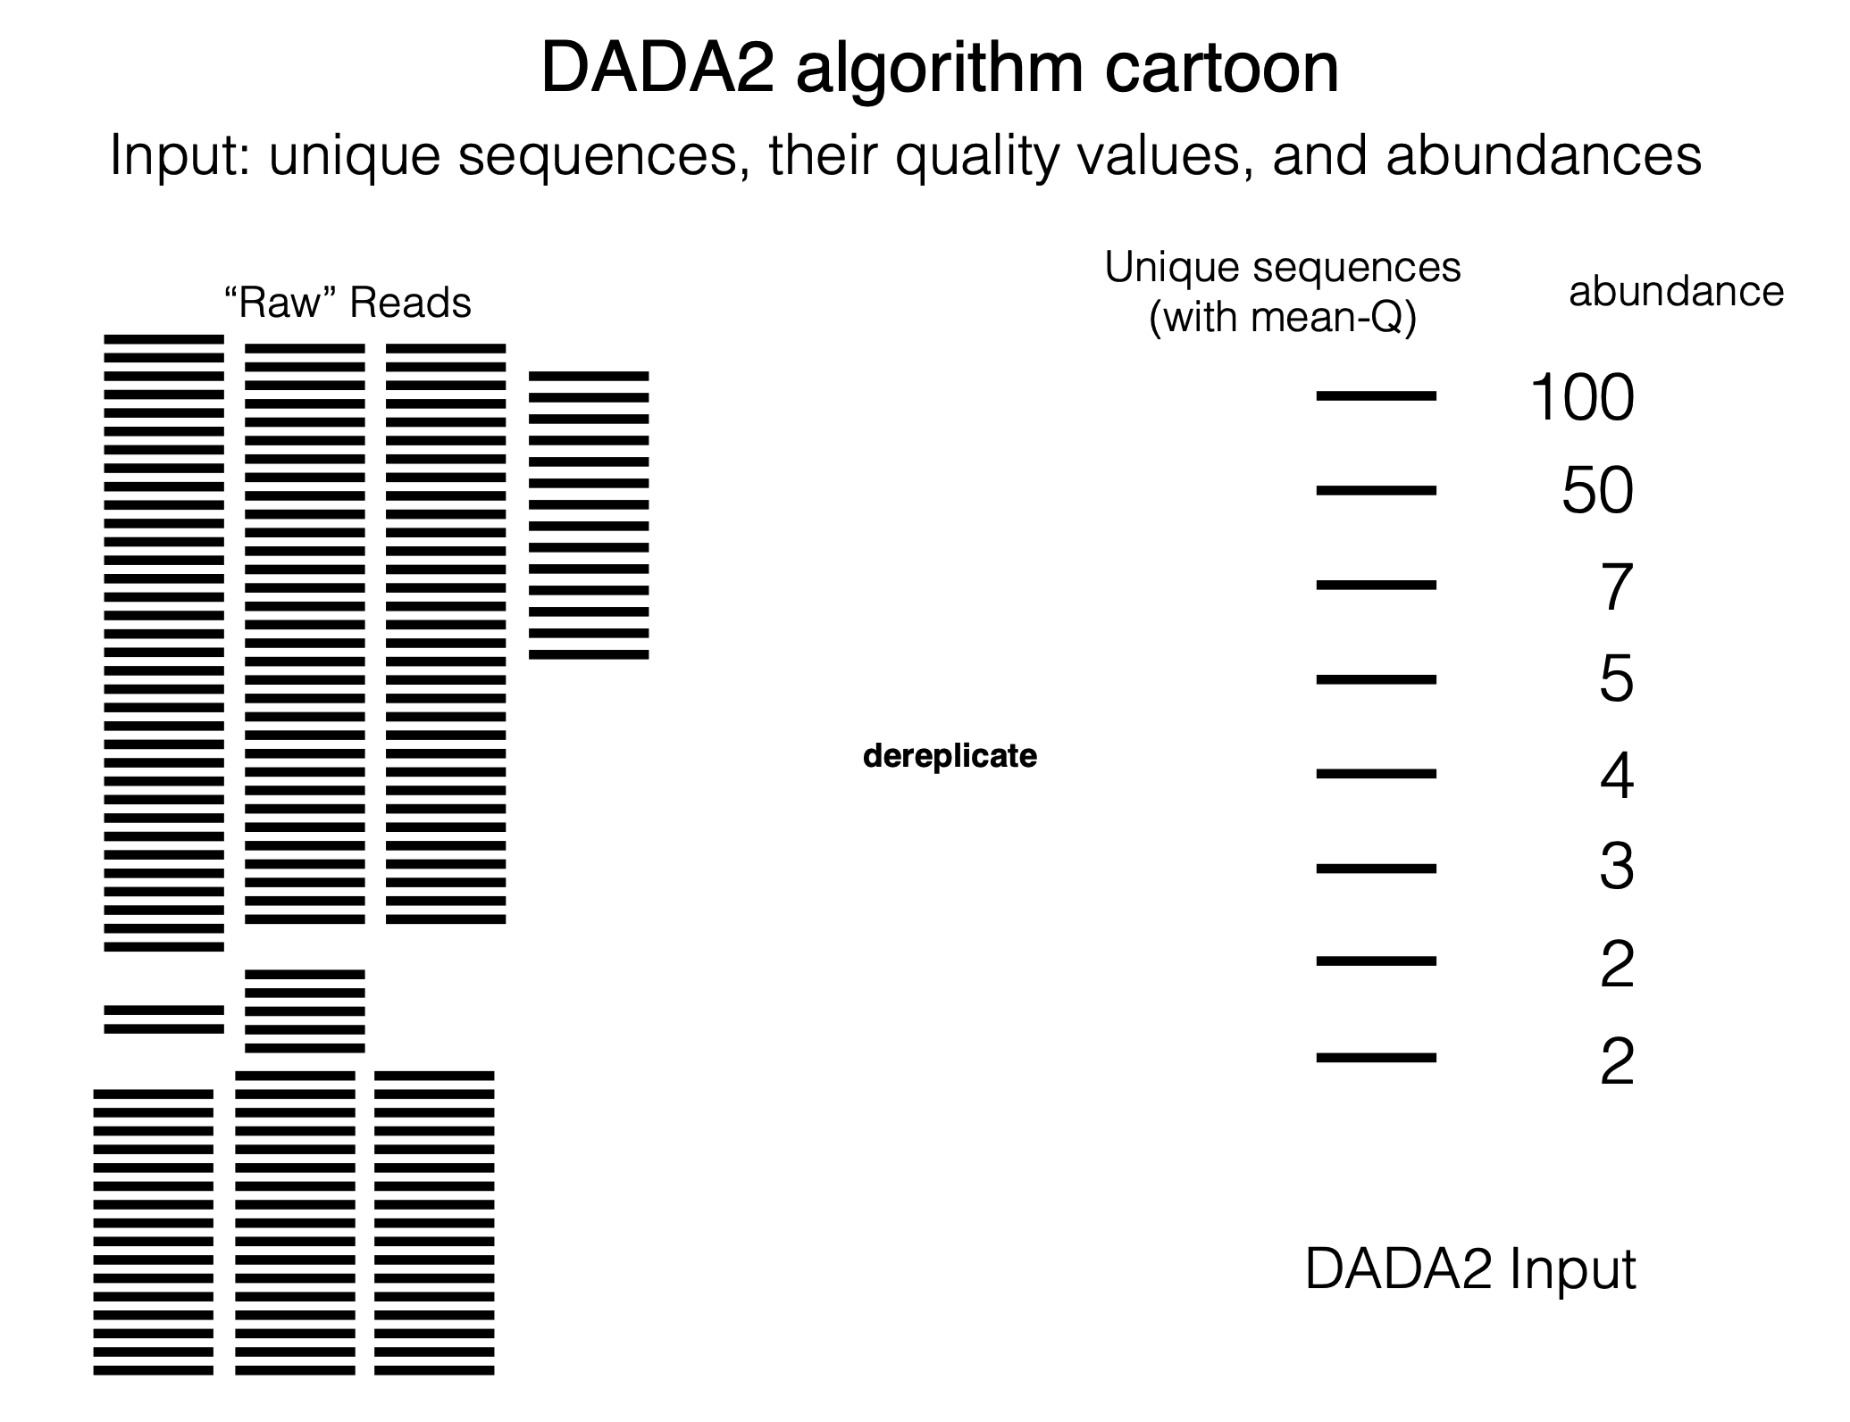
https://www.biostat.washington.edu/sites/default/files/modules/2018-SISMID-01b.pdf

Slide 28
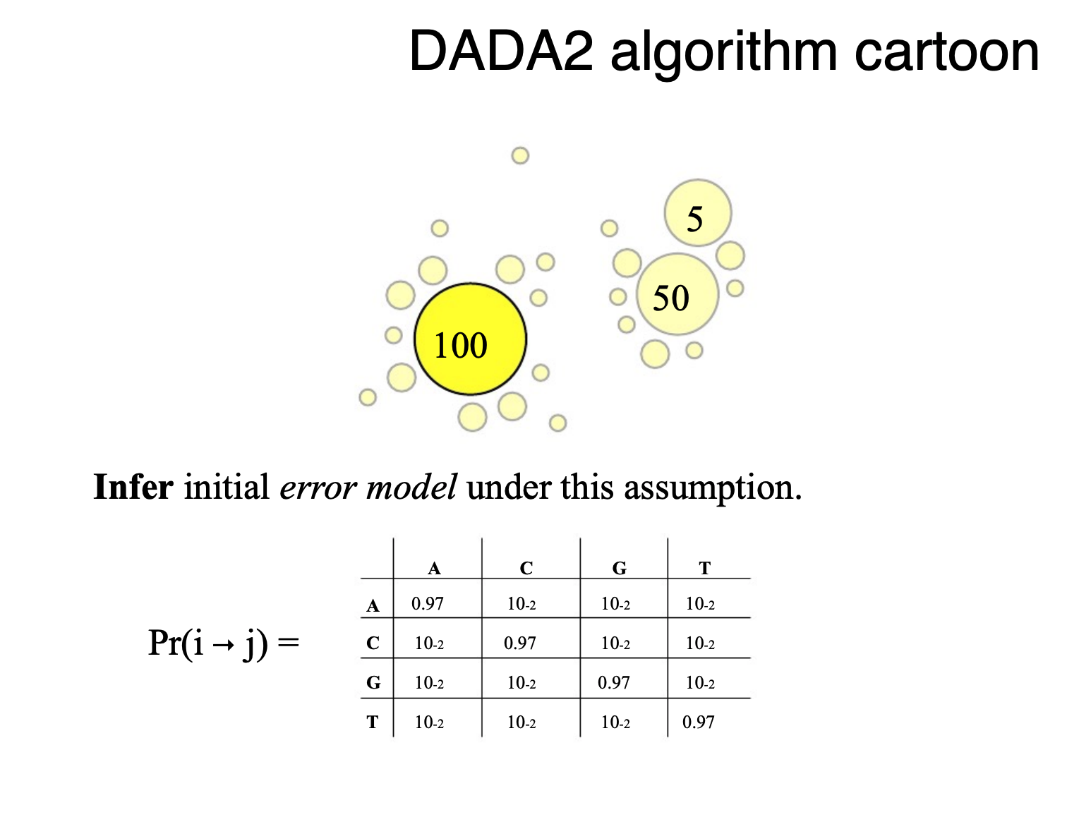
Two models:
Error Model
Abundance model (p-value)
https://www.biostat.washington.edu/sites/default/files/modules/2018-SISMID-01b.pdf
Notes:
Expected abundance of seq i is calculated by assuming that it is generated by errors mulitplied by abundance of j. Is the observed value greather than what you expected? P-values is small means that there are more sequences of j than you expect if they were errors of sequence j give the abundance of it.

Slide 29
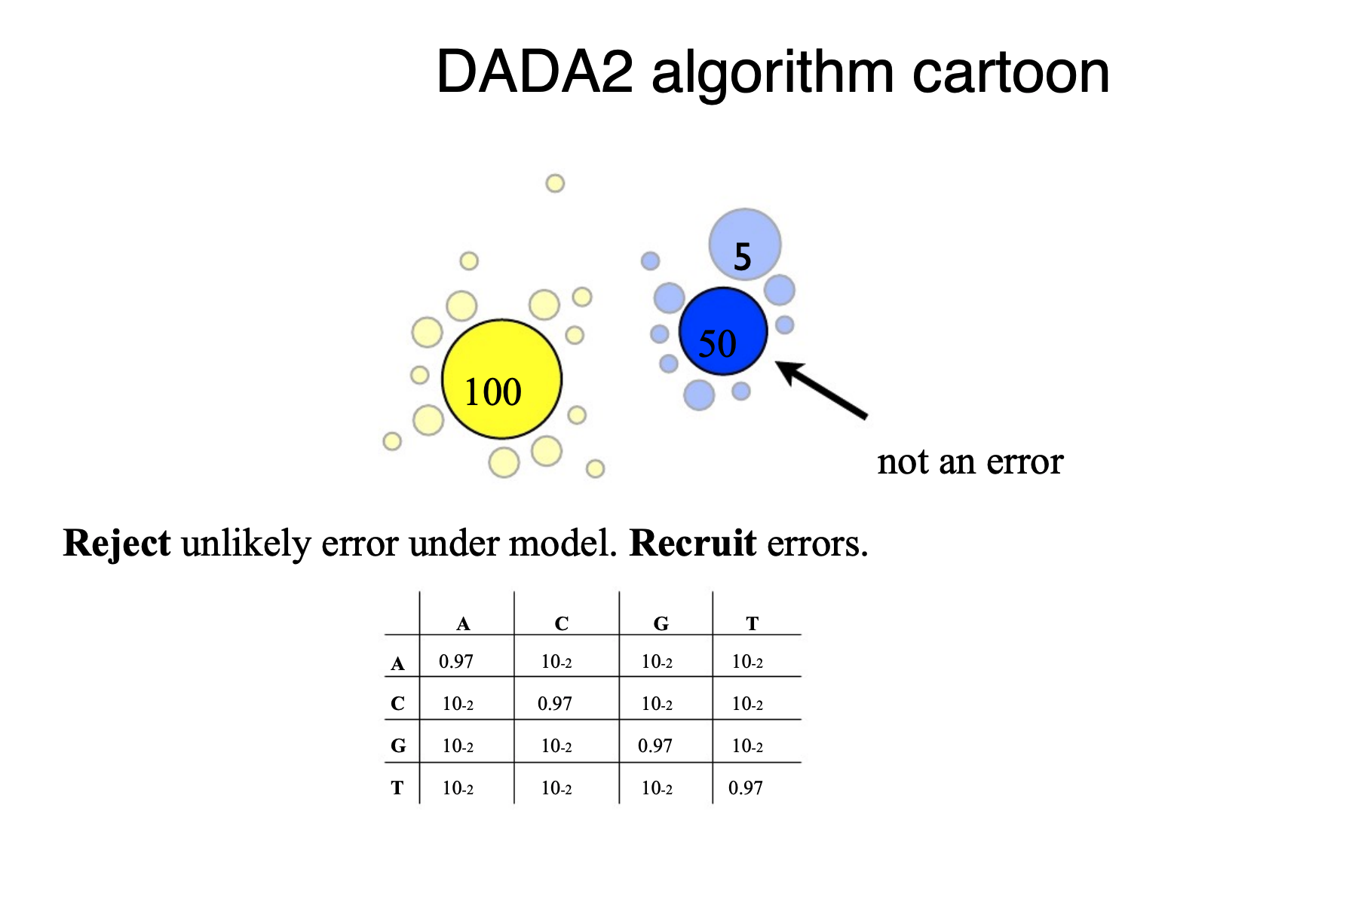
https://www.biostat.washington.edu/sites/default/files/modules/2018-SISMID-01b.pdf

Slide 30
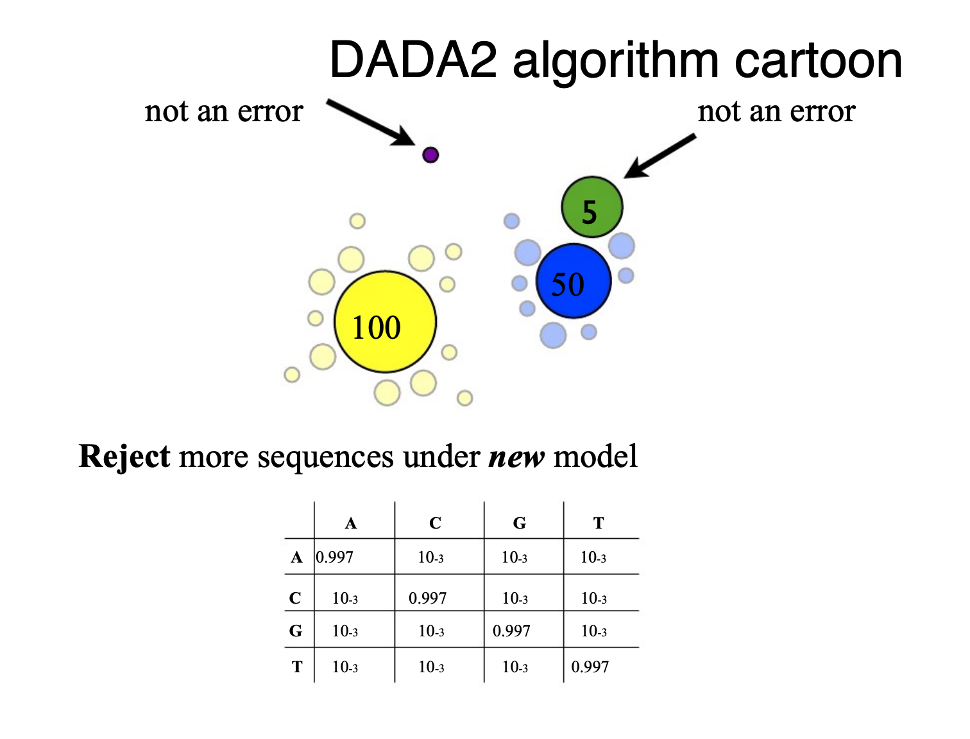
https://www.biostat.washington.edu/sites/default/files/modules/2018-SISMID-01b.pdf

Slide 31
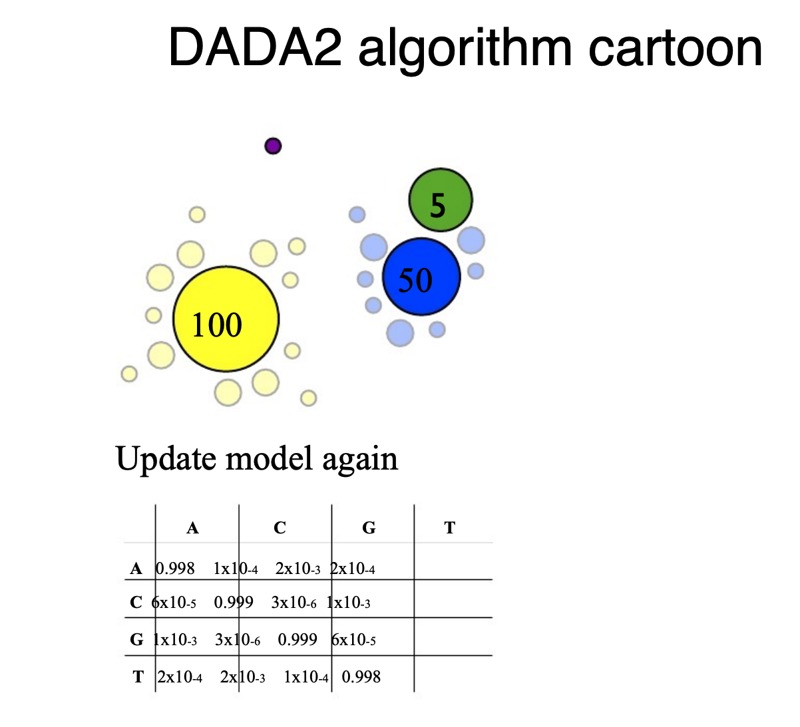
https://www.biostat.washington.edu/sites/default/files/modules/2018-SISMID-01b.pdf

Slide 32
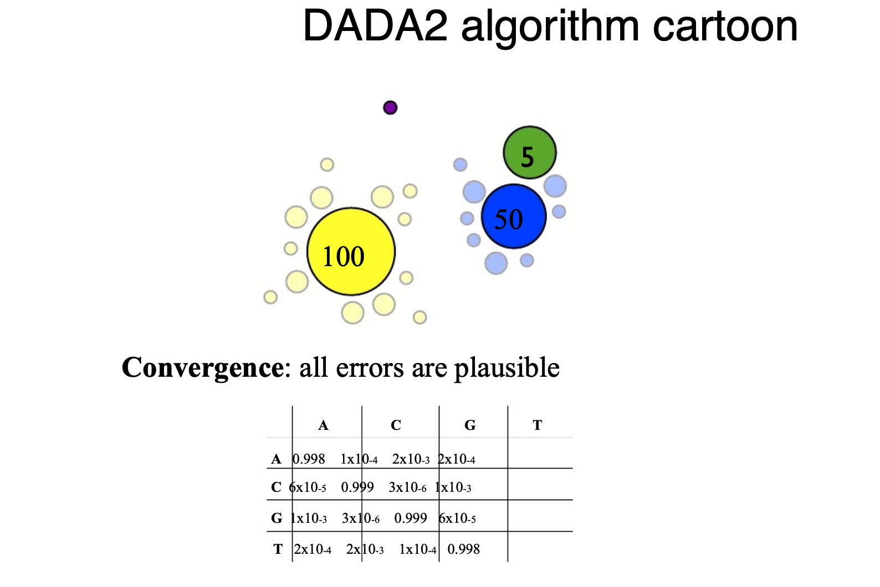
https://www.biostat.washington.edu/sites/default/files/modules/2018-SISMID-01b.pdf

Slide 33
Merge Paired End Reads
Overlap
FWD
Primer
Read length
REV
Chimeric Sequences
Biological Sequence X
Biological Sequence Y
Chimera formed from X and Y
Created during PCR
Fragment primes different extension
About 1-5 % of reads are chimeric
Source: Lahr & Katz, 2009
Notes:
Chimeras are sequences formed from two or more biological sequences joined together. Amplicons with chimeric sequences can form during PCR. Although chimeras can be formed by a number of mechanisms, the majority of chimeras are believed to arise from incomplete extension. During subsequent cycles of PCR, a partially extended strand can bind to a template derived from a different but similar sequence.

Slide 34
Important:
DADA2 gives us Amplicon sequence Variants (ASVs) not operational taxonomic units OTUs

Slide 35
Reference Databases
&
Taxonomy Assignment

Slide 36
Reference Databases
SILVA
Taxonomy | Type | No. of nodes | Lowest rank | Latest release
SILVA | Manual | 12,117 | Genus | Dec 2017
RDP-II | Semi | 6,128 | Genus | Sep 2016
Greengenes | Automatic | 3,093 | Species | May 2013
GTDB | Automatic | 143,512 | Species | Todayª
388
RDP-II
621
170
949
91
0
57
Source: Balvočiūtė et al 2017
Use a small set of authoritatively classified sequences such as RDP training set or SILVA LTP subset
Greengenes
Source: Yilmaz et al 2013
Notes:
enn diagram showing the number of shared taxa at genus level between SILVA, RDP-II and Greengenes. Only taxa containing sequences from cultivated organisms are included in this comparison.

Slide 37
Taxonomy Assignment
Method of reference
Data used for classification
Taxonomic Inference
Available Tools
Alignment-Based
Sequence Alignment
Reference Sequences
Identity thresholds
MEGAN5, RTAX
Composition-Based
Shared Feature Vectors (K-mers)
Shared Feature Vectors & probability of taxonomic inclusion
Quantity or proportion of feature vectors shared between reference and query sequence
RDP Classifier, UTAX
Source : Richardson et al., 2016

Slide 38
SUGGESTIONS
Length & Depth
Know which region, read
length & depth suits your
experiment
Denoise (DADA2)
Remove errors
Know Why
Understand why you are using a tool or method
Negative Controls
Helps identify contaminants
Avoid C.R. Clustering
Unless you have a very good
reason, avoid.
Sample size
Are there enough samples for
down stream analysis
Be consistent
It is much better to use the same methods than to change methods frequently

Slide 39
"If you torture the data long enough, it will confess."
- Ronald Coase, Economist

